Slide 1
Model to predict customer churn rate
Online help
Presentation: Do Thi Lan

Slide 2
TABLE OF CONTENS
01
02
03
04
INTRODUCTION
DATA OVERVIEW
MODEL TRAINING
AND EVALUATION
CONCLUSION

Slide 3
01. INTRODUCTION
Customer churn prediction is a critical aspect of business management. It involves understanding and addressing customer attrition, which refers to the loss of clients or customers.
Retaining an existing customer is significantly more cost-effective than acquiring a new one. The long-term value of recovered customers far outweighs that of newly acquired ones.

Slide 4
➔ To address customer churn, predictive analytics comes into play, churn prediction models to assess the likelihood of customers leaving.

Slide 5
02
DATA OVERVIEW
Online help

Slide 6
Two datasets are provided for this project share the same attributes or features:
churn-bigml-80.csv
churn-bigml-20.csv
Contains 2666 rows (customers) and 20 columns (features).
Intended for training and cross-validation purposes.
Used for developing machine learning models.
Contains 667 rows (customers) and 20 columns (features).
Intended for final testing and model performance evaluation.

Slide 7
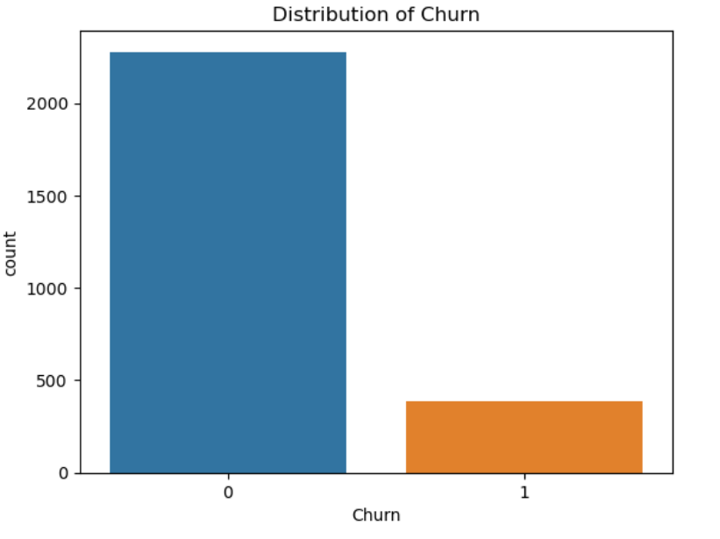
Number of churn customer: 388
Number of who not churn customer: 2278
The data is imbalanced mainly due to customer churn patterns
This imbalance must be handled before being included in the model
Accuracy should not be used for this data set, AUC should be used

Slide 8
MODEL TRAINING AND EVALUATION
03
Help

Slide 9
MODEL TRAINING AND EVALUATION
Divide the data set
Select features
Handle data imbalance
Choose a machine learning model

Slide 10
DIVIDE THE DATA SET
churn-bigml-80.csv
churn-bigml-20.csv
Used as training set, applying machine learning model
Intended for final testing and model performance evaluation.

Slide 11
HANDLE DATA IMBALANCE
UNDERSAMPLING
OVERSAMPLING
Truncate the majority samples that do not churn
Increase churn samples
Choose coefficient Sampling_strategy = 1
Choose coefficient Sampling_strategy = 0.5
Randomly selected 1139 sample does not churn
Increase churn sample from 338 to 1139

Slide 12
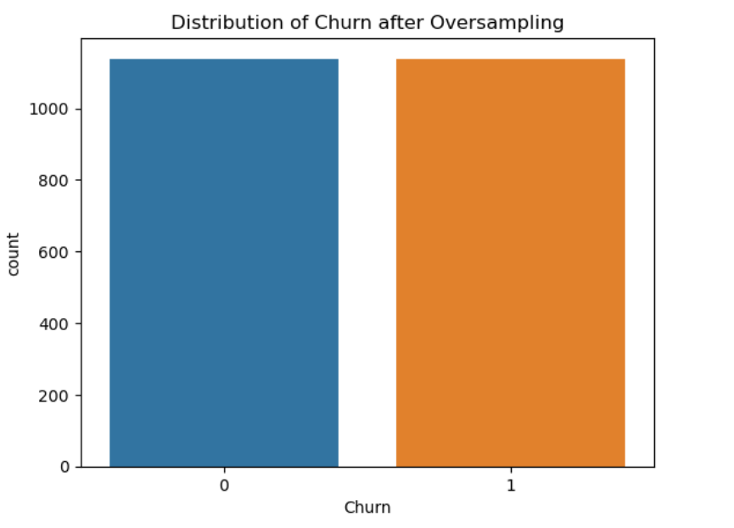
Results after balancing the data

Slide 13
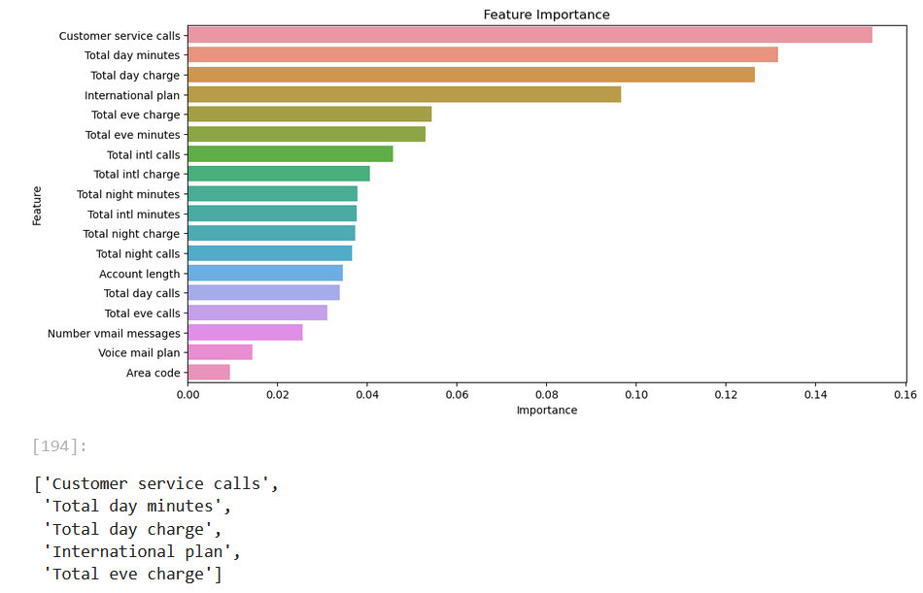
SELECT FEATURES
Training a Random Forest model
Use the feature_importances_ attribute to evaluate the importance of features
Features with higher importance will be selected into the top 5

Slide 14
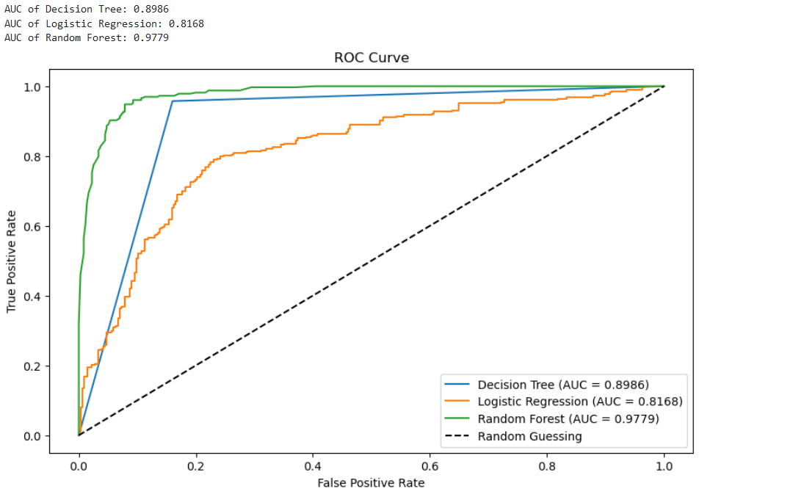
CHOOSE A MACHINE LEARNING MODEL
Choose Random Forest because it helps minimize overfitting and improve accuracy on complex data sets.

Slide 15
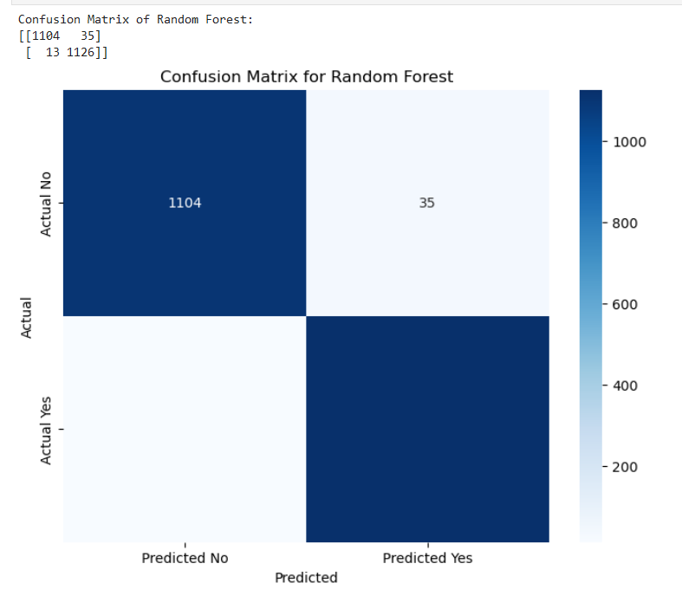
CHOOSE A RANDOM FOREST
The number of cases in which customers were correctly predicted to leave the service is 1126
Number of cases where it was wrongly predicted that customers would churn when in fact they did not 35
The number of cases where it was incorrectly predicted that customers would not churn when they actually did 13
The number of cases that were correctly predicted that customers would stay and actually stayed was 1104

Slide 16
04. CONCLUSION
The problem of the problem is to predict the likelihood that customers will leave, it is not related to legal issues so it is not too important in explaining therefore Random Forest will provide the best classification performance in predicting churn take care of customer service.

Slide 17

Thanks!
Do you have any questions? dothilan1123@gmail.com | +84 972 769 157
https://github.com/DoLan662003/TestDA
Online help

